Slide 1
Ambient Aerosol Sampling
Christiana Lee
March 29, 2010

Slide 2
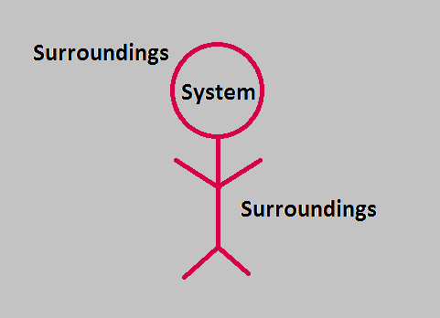
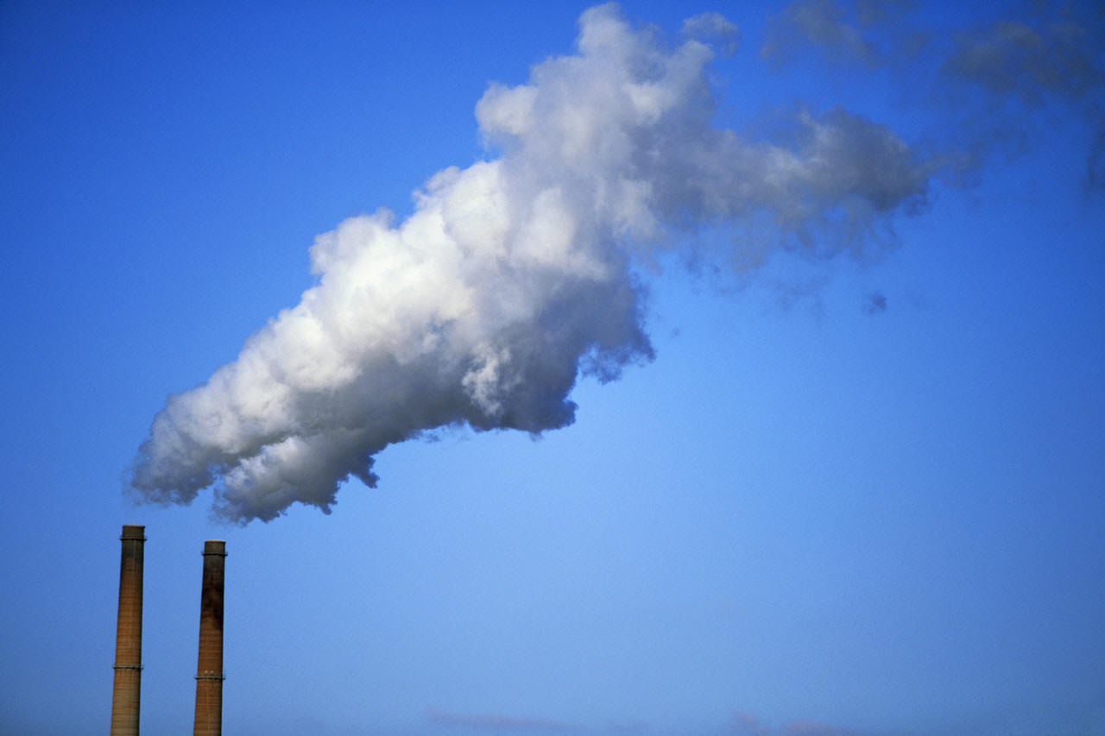
What is an Ambient Aerosol?
Ambient measurements concern a system’s surroundings (indoor or outdoors).
Ambient aerosols are not measured at or near the point of generation.
Humans are effected by ambient aerosols because they are the ones with which we come into contact.
www.TodaysSeniorNetwork.com
Notes:
Ambient aerosols are volume of surroundings means aersol concnetration should not change as a result of sampling, semi-infinite assumption.

Slide 3
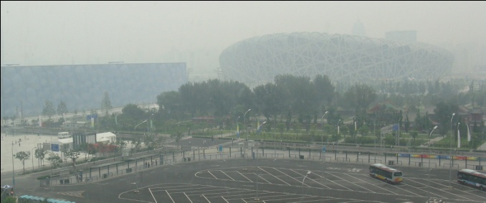
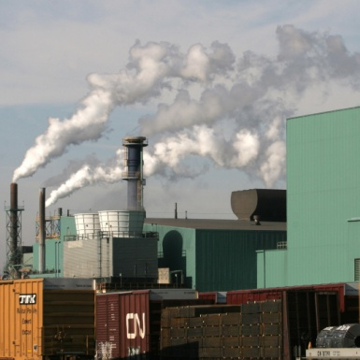
Reasons for Measurement
Government Regulations/ Safely
Health
Pollution
Visibility
Determine Source
Research
How pollen travels
Impact of sugar cane burning
www.Wikipedia.com

Slide 4
Objectives
Understand the requirements for obtaining different ambient aerosol samples.
Discover methods to meet specific requirements.
Familiarize yourself with existing sampling units.

Slide 5
Sampling System Requirements
Type of aerosol
Size Reactivity/interactions
Concentration
Prevent saturation Conc. stability Collection time
Information needed
Viability Size Composition
Practicality
Cost effective
Availability
Ease of use
Government Regulation
System Req.
Aerosol Type
Conc.
Info. Needed
Gov. Regulation
Practicality
Notes:
Large and small aerosols are collected differently
Aerosol must not deteriorate/ react with collection medium
Collection should not destroy/ change aerosol
Ex. A cellulose membrane filter would not be good for collecting acidic aerosols. Flammable aerosols should not be collected by a traditional ESP.
Ex. An cascade impactor can collect so much aerosol it changes the cut size of each stage because of the changing geometry
Ex. NIOSH Occupational Asbestos exposure limit is determined by samples taken around the breathing zone by an open face filter holder containing a specific celulose membrane filter. Sampling flow rates are predetermined and quantification is done by optical microscope.

Slide 6
Meeting Aerosol Requirements
Is there a prescribed gov. technique?
Yes
Use prescribed method
Challenge current method, see next page
No
See next page
Health/visibility related measurements have standard government collection/quantification methods.
Notes:
EX. The Asbestos limits are determined by filter because it has high collection efficiency. They are counted by optical microscope because asbestos causes negative health effects based on number of fibers. Mass counting is not applicable because in a working environment there may be other particles in the air such as sawdust that would skew mass based measurements, therefore it is counted by microscope

Slide 7
Meeting Aerosol Requirements
Inlet
Materials
Collection Device
Flow Controller
Pump
A single dichotomous key for choosing a collection method would be too complex.
The collection methods outlined are popular ambient aerosol collection techniques.
Using data on the pros and cons of each technique it is possible to choose an appropriate collection method.

Slide 8
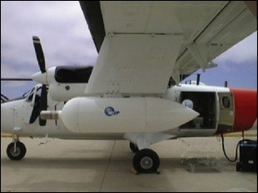
Questions?
What would be some challenges in designing a sampling system on a plane?

Slide 9
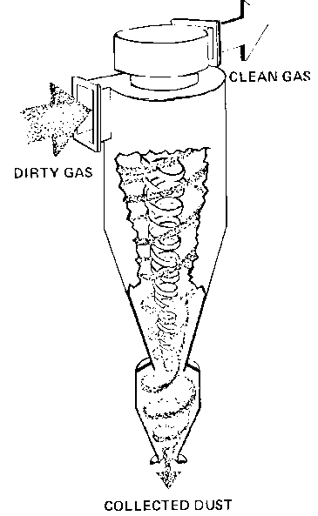
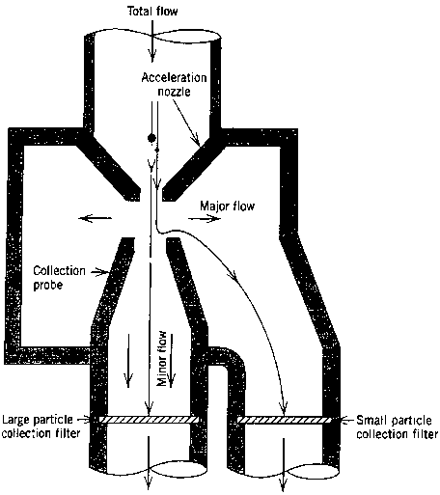
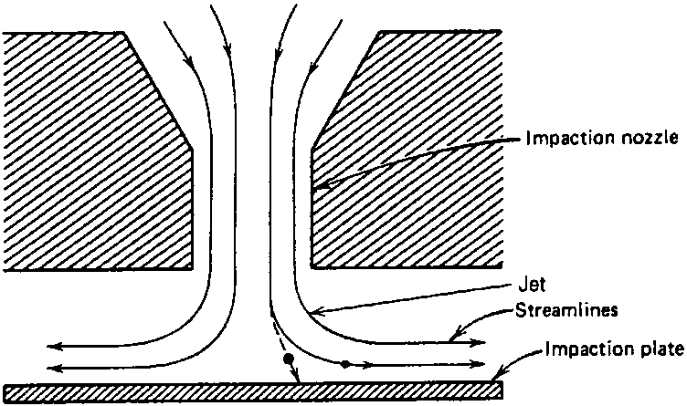
Sampling Inlets
Inlet
Materials
Collection Device
Flow Controller
Pump
Sampling inlets provide selective size collection
Isokinetic
Direct and virtual Impaction
Cyclonic Flow
Selective Filtration
Elutriation
Notes:
Explain the way each sampling inlet works.
Class familiar with imaction, cyclonic flow.
Mention about membrane filters (works like sieve)
Elutriation is similar to settling chamber

Slide 10
Question?
I want to know the concentration of pollen in the air for Gainesville. What would be a good sampling inlet and why?

Slide 11
Materials
Inlet
Materials
Collection
Device
Flow Controller
Pump
Desirable characteristics
Strong, reusable
Uncharged
Charged materials change collection
Use conductive tubing
Non-reactive / resistant
To environment
To aerosol
Stainless steel (+durable, -expensive)
Plastic (+lightweight, - charged)
Oxidized Aluminum (+lightweight)
Notes:
S.S, plastic, oxidized alluminum

Slide 12
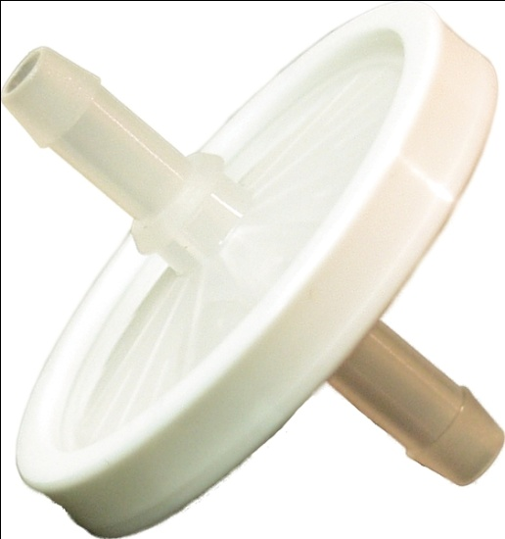
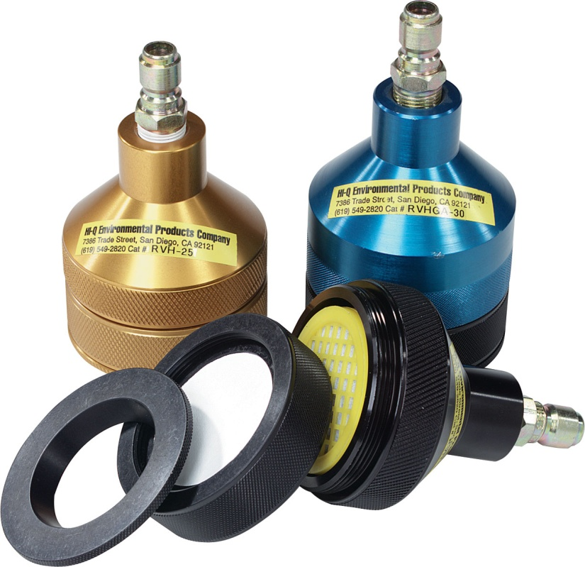
Collection Devices: Filters
In-line filter holder
Can connect to upstream size selective inlet
Aerosol flow directed to center of filter
Open face filter holders
No inlet
Aerosols distributed evenly across filter
Require careful placement
Hi-Q Environmental Products
Notes:
Hepa collect 99.97% at most penetrating particle size 0.3 micrometers
Mass quantification is the simplest method, requires high loading and sensitive scale
Counting can be time consuming but allows for some selectivity (like mentioned about the asbestos), not good for high loading.
Dissolving good for low quantities where mass is hard to detect.
Chemical quantification is species selective and useful if there is more than one type of aerosol collected.
Florescence and absorbance are easy, useful tools as long as the matrix effect has been taken into account. Matrix effect refers to the interference of solvent and other dissolved particles.
Viability assay is used for bioaersols and you’ll see how that is done in lab 3. It works for low and high concretions.

Slide 13
Collection Devices
Inlet
Pump
Flow Controller
Collection Device
Materials
Filters are very common collectors
Many quantification options exist
Weigh Mass
Count by microscope
Dissolve
Chemical quantification
Florescence/Absorbance
Viability assay
Notes:
Hepa collect 99.97% at most penetrating particle size 0.3 micrometers
Mass quantification is the simplest method, requires high loading and sensitive scale
Counting can be time consuming but allows for some selectivity (like mentioned about the asbestos), not good for high loading.
Dissolving good for low quantities where mass is hard to detect.
Chemical quantification is species selective and useful if there is more than one type of aerosol collected.
Florescence and absorbance are easy, useful tools as long as the matrix effect has been taken into account. Matrix effect refers to the interference of solvent and other dissolved particles.
Viability assay is used for bioaersols and you’ll see how that is done in lab 3. It works for low and high concretions.

Slide 14
Collection Devices: Filters
Inlet
Materials
Collection Device
Flow Controller
Pump
Choosing a filter requires consideration of multiple parameters
Removal Efficiency
Pressure drop
Compatibility
Aerosol
Environment
Quantification technique
Cost
Notes:
Hepa collect 99.97% at most penetrating particle size 0.3 micrometers
Mass quantification is the simplest method, requires high loading and sensitive scale
Counting can be time consuming but allows for some selectivity (like mentioned about the asbestos), not good for high loading.
Dissolving good for low quantities where mass is hard to detect.
Chemical quantification is species selective and useful if there is more than one type of aerosol collected.
Florescence and absorbance are easy, useful tools as long as the matrix effect has been taken into account. Matrix effect refers to the interference of solvent and other dissolved particles.
Viability assay is used for bioaersols and you’ll see how that is done in lab 3. It works for low and high concretions.

Slide 15
Collection Devices: Filters
Inlet
Materials
Collection Device
Flow Controller
Pump
Fiber Filter
Tightly woven mat of fibers
High efficiency, HEPA
Glass Fiber
Borosilicate glass
Compatible with acidic conditions
High temp compatible
Cellulose Fiber
Paper
Hydroscopic
Flammable
Notes:
Borosilicate Glass, same stuff pyrex is made out of

Slide 17
Collection Devices: Filters
Inlet
Materials
Collection Device
Flow Controller
Pump
Membrane/Pore Filter
Controlled pore size
Flat surface, good for microscopy
Etched Polycarbonate
Does not react with most aerosols or analysis techniques
Low sampling efficiency, <80%
Can retain charge
Teflon
Composed of stretched Teflon sheet
Incompatible with high sampling rate

Slide 20
Collection Devices: Other
Inlet
Materials
Collection Device
Flow Controller
Pump
Non-filter samplers can be used for ambient aerosol sampling
All sampling methods discussed in class can be applied to ambient aerosols
Cascade Impactor
ESP (Electrostatic Precipitator)
SMPS
UV -APS (UV monitor and Aerodynamic Particle Sizer)
Grimm (90 degree light scattering)
Biobadge (rotating impaction surface)
Notes:
Borosilicate Glass, same stuff pyrex is made out of

Slide 21
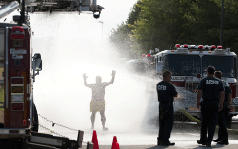
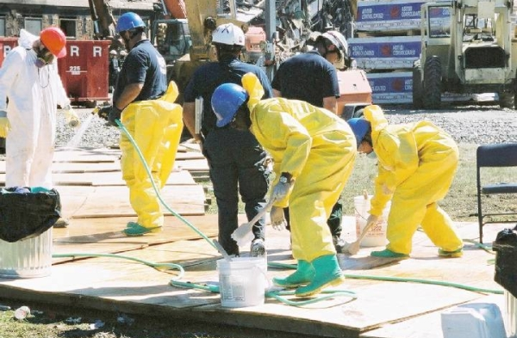
Real Life Application
Pentagon Biodefense Test (2009)
Multistage Impactor
SMPS
APS
Grimm
Open face filter
Non-flow collection (Slides for RAMAN)

Slide 22
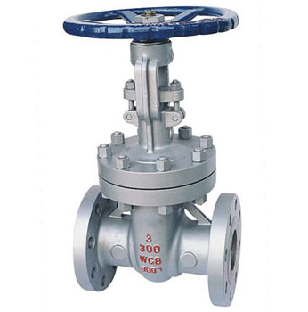
Flow Controller
Inlet
Materials
Collection Device
Flow Controller
Pump
Flow rate must be known for ambient concentration data can be obtained
Manual Options
Rotometer
Flow must be particle free
Require constant calibration
Valve
Requires downstream flow meter or specific knowledge of system
Cheapest option

Slide 23
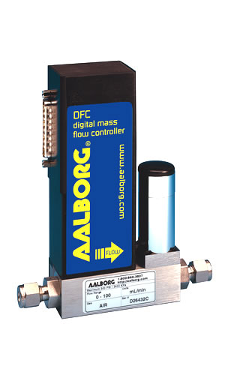
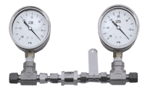
Flow Controller
Inlet
Materials
Collection Device
Flow Controller
Pump
Automatic
Mass flow controller
Particle free stream required
Based on heat transfer
Expensive
Critical Orifice Volume
Small circular orifice between collector and pump.
Air velocity reaches sonic speed resulting in stable flow rate
Low flow rates and very strong pump required

Slide 24
Pump
Inlet
Materials
Collection Device
Flow Controller
Pump
Pumps are required for most ambient sampling because they work on negative pressure.
Pumps must be able to operate in desired flow and pressure range
Pumps must be compatible with environment
Denuder to remove acid
Desiccator for humidity
Downstream filter to remove particles
Notes:
Borosilicate Glass, same stuff pyrex is made out of

Slide 25
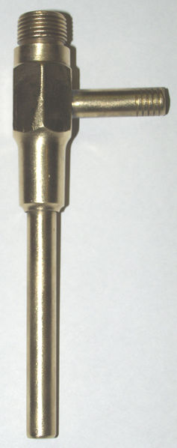
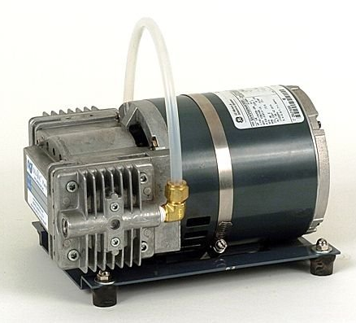
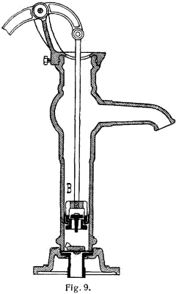
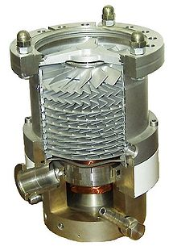
Pump
Positive Displacement
Expands diaphragm, seals it off, exhausts to air and repeats
Good for low vacuum
Momentum Transfer
Adds forward momentum to gas molecules by turbine or liquid jets
Good For high vacuum
Entrapment
Adsorb or condense gas molecules, ex. Cryopumps
Combination pumps

Slide 26
Recap
Requirements for obtaining different ambient aerosol samples.
Methods to meet specific requirements.
Existing ambient aerosol sampling units.

Slide 27
Questions?

Slide 28
References
Lodge, J.P. Methods of Air Sampling and Analysis, 3rd Ed. pp.190-212
Hinds, W.C. Aerosols Technology, 2nd Ed.

